Slide 1
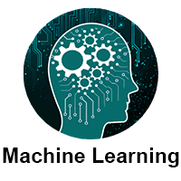
Overview
Phouthone Vongpasith
56491445
vongfeng@gmail.com
https://www.javatpoint.com/machine-learning

Slide 2
Outline
What is Machine Learning
How does Machine Learning work
Features of Machine Learning
Need for Machine Learning
Classification of Machine Learning
Supervised Learning
Unsupervised Learning
Reinforcement Learning
History of Machine Learning
Machine Learning at present
Prerequisites

Slide 3
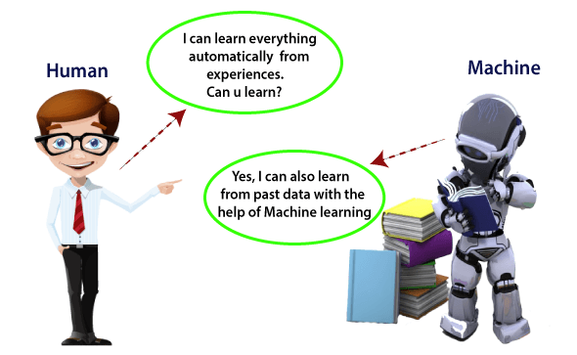
What is Machine Learning
Machine learning enables a machine to automatically learn from data, improve performance from experiences, and predict things without being explicitly programmed.

Slide 4
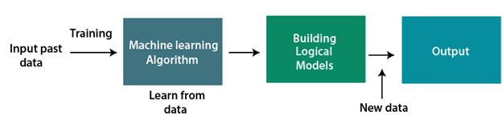
How does Machine Learning work
A Machine Learning system learns from historical data, builds the prediction models, and whenever it receives new data, predicts the output for it.

Slide 5
Features of Machine Learning
Machine learning uses data to detect various patterns in a given dataset.
It can learn from past data and improve automatically.
It is a data-driven technology.
Machine learning is much similar to data mining as it also deals with the huge amount of the data.

Slide 6
Need for Machine Learning
Rapid increment in the production of data
Solving complex problems, which are difficult for a human
Decision making in various sector including finance
Finding hidden patterns and extracting useful information from data.

Slide 7
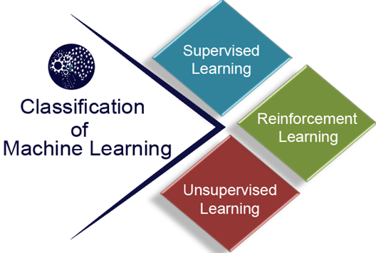
Classification of Machine Learning
At a broad level, machine learning can be classified into

Slide 8
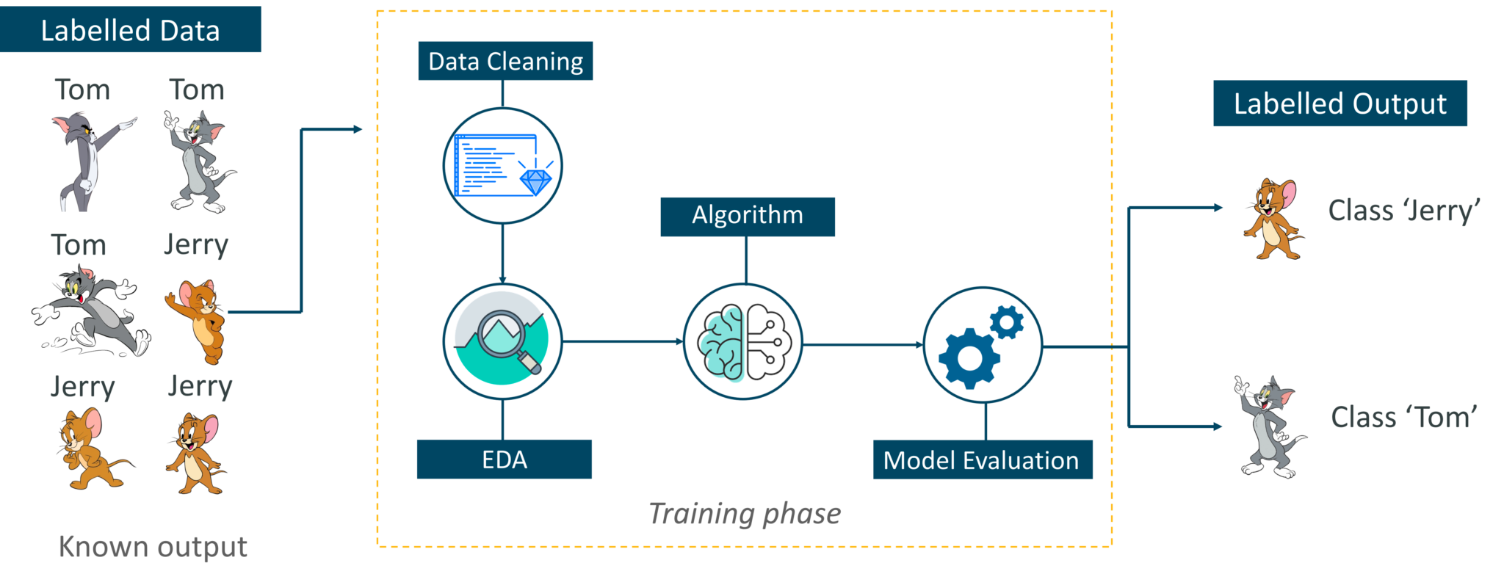
Supervised Learning
A labeled data is provided in order to train it, and on that basis, it predicts the output.
It grouped in two categories of algorithms:
  Classification, Regression

Slide 9
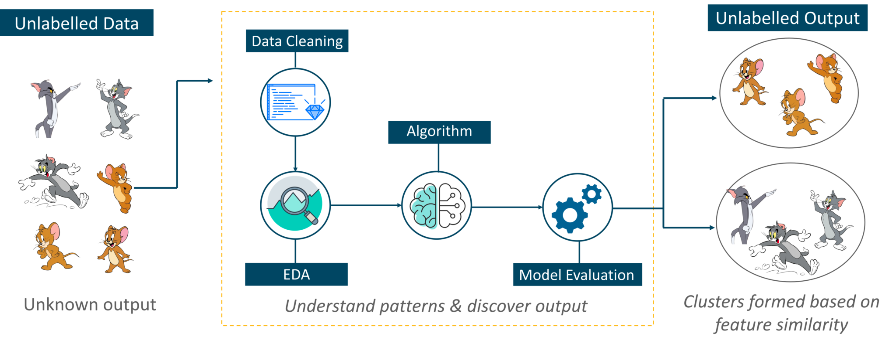
Unsupervised Learning
A learning method in which a machine learns without any supervision.
It classifieds into two categories of algorithms:
  Clustering
  Association

Slide 10
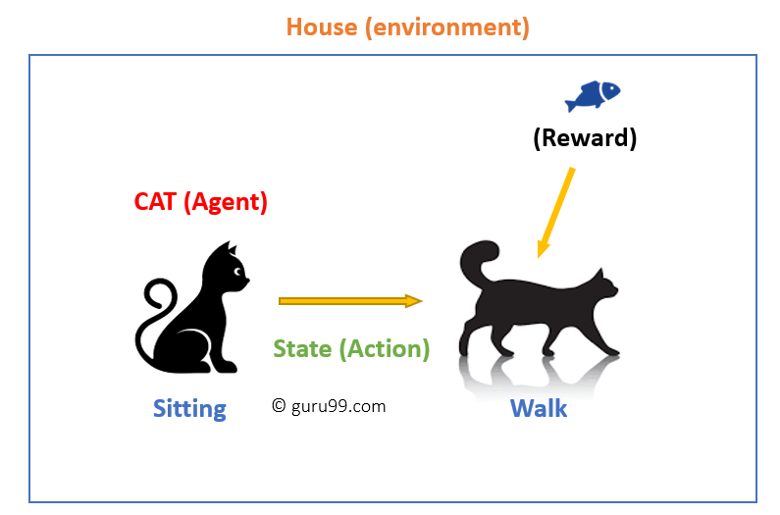
Reinforcement Learning
A feedback-based learning method, in which a learning agent gets a reward for each right action and gets a penalty for each wrong action.

Slide 11
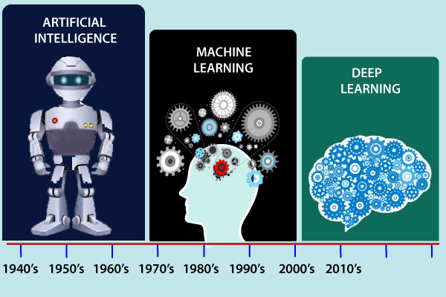
History of Machine Learning
Before some years (about 40-50 years), machine learning was science fiction, but today it is the part of our daily life.

Slide 12
History of Machine Learning
History of Machine Learning
The early history of Machine Learning (Pre-1940)
The era of stored program computers
Computer machinery and intelligence
Machine intelligence in Games
The first "AI" winter
Machine Learning from theory to reality
Machine Learning at 21st century 1
Machine Learning at 21st century 2
Machine Learning at present
Prerequisites
https://www.javatpoint.com/applications-of-machine-learning

Slide 13
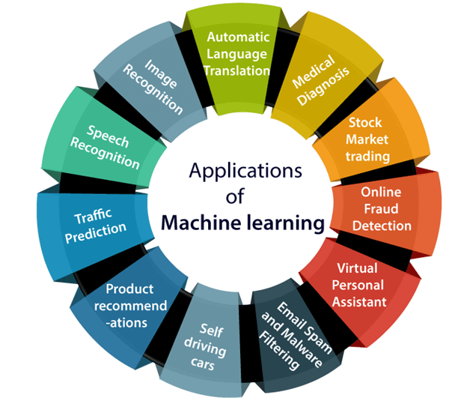
Applications of Machine learning
A buzzword for today's technology, and it is growing very rapidly day by day.
1. Image Recognition:
2. Speech Recognition
3. Traffic prediction:
4. Product recommendations:
5. Self-driving cars:
6. Email Spam and Malware Filtering:
7. Virtual Personal Assistant:
8. Online Fraud Detection
9. Stock Market trading:
10. Medical Diagnosis
11. Automatic Language Translation:
https://www.javatpoint.com/applications-of-machine-learning

Slide 14
ລາຍຊື່ນັກສຶກສາ ປທ. ຮຸ້ນ 2
1. ອານຸຄອນ ນາກະວົງ 5(9/10),5(16/10)
2. ອຸທິກອນ ຫຼ້າບຸນທັນ 5,5
3. ທະວີສຸກ ຂຸນລາຊາພິທັກ 5,5
4. ຄຳພອນ ພຸດທະວົງ 0,5
5. ທອງຈັນ‍‍‍‍ ຈັນທະວົງ 5,5
6. ພັດທະນາ ສຸຂະນຸວົງ 5, 5
7. ພອນສະຫວັນ ຈ່າຈື່ຢ່າງ5,5
8. ສົມພະໄທ ລາດຊະວົງ 5,5
9. ໄຊຍະສິດ ຈັນທະວົງ5,,5
10. ຈິນດາ ໃຈອີສານ 5,5

Slide 15
Class Work 1
GDP = a $, Mac = ?
  1000
  2000
  3000
  4000
  5000
  6000
  7000
  8000
  9000
  10000
https://www.youtube.com/watch?v=1Rkt8Zk3KBM&list=PLoTScYm9O0GH_3VrwwnQafwWQ6ibKnEtU&index=2

